Slide 1
FOOTBALL PLAYER RATING PREDICTION
Guided By-
Prof. Suhas Joshi
PA 68 Akshit Langeh
PB 75 Shubh Sharma
PA 58 Prathamesh Joshi
PB 07 Aditya Jaiswal

Slide 2
Problem Statement
The problem of evaluating the performance of a football player is attracting a lot of companies and scientific communities, thanks to the availability of a massive data being generated during a match.
Thus the football player rating predictor is a consolidated metric that can be used to not only provide the present but also the future potential ratings of a player.

Slide 3
Scope
Selecting new talents is unfeasible for Player Scouts as it is too much time consuming and there is a major need for data analysis.
Thus data-driven performance scores could help in selecting a small subset of the best players who meet specific constraints or show some pattern in their performance.
This allows scouts and clubs to analyse a larger set of players and saving considerable time and economic resources while broadening scouting operations and career opportunities of the talented players.
Not only in football but also various fantasy football uses such evaluations to compare performance of professional players. Due to availability of a massive data being generated during a match training dataset to our needs is feasible.
Also this model is not limited to only football any other sport with similar database.

Slide 4
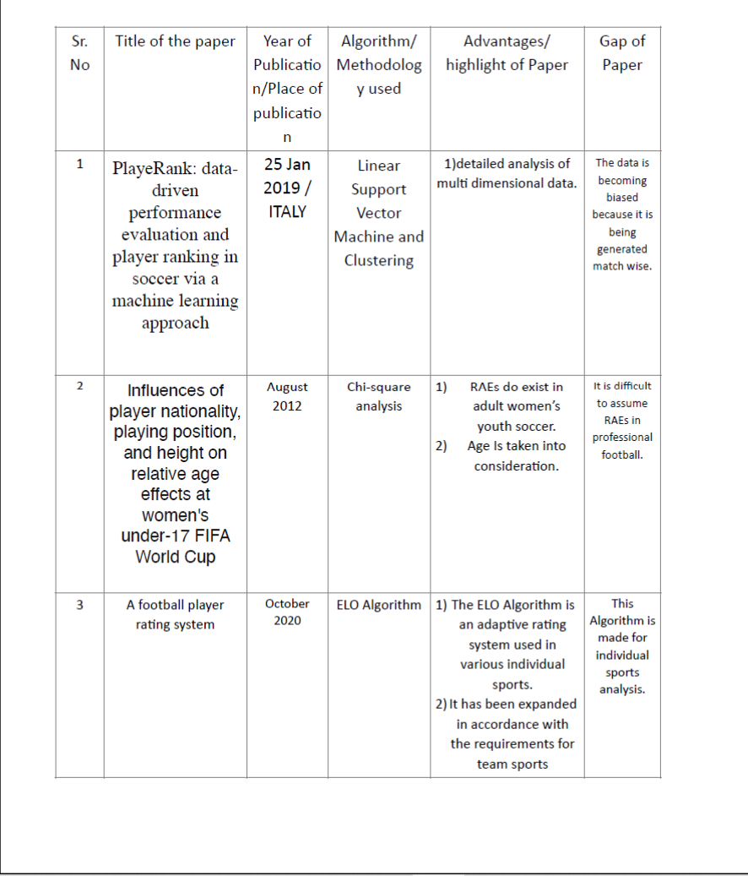
Literature Survey

Slide 5
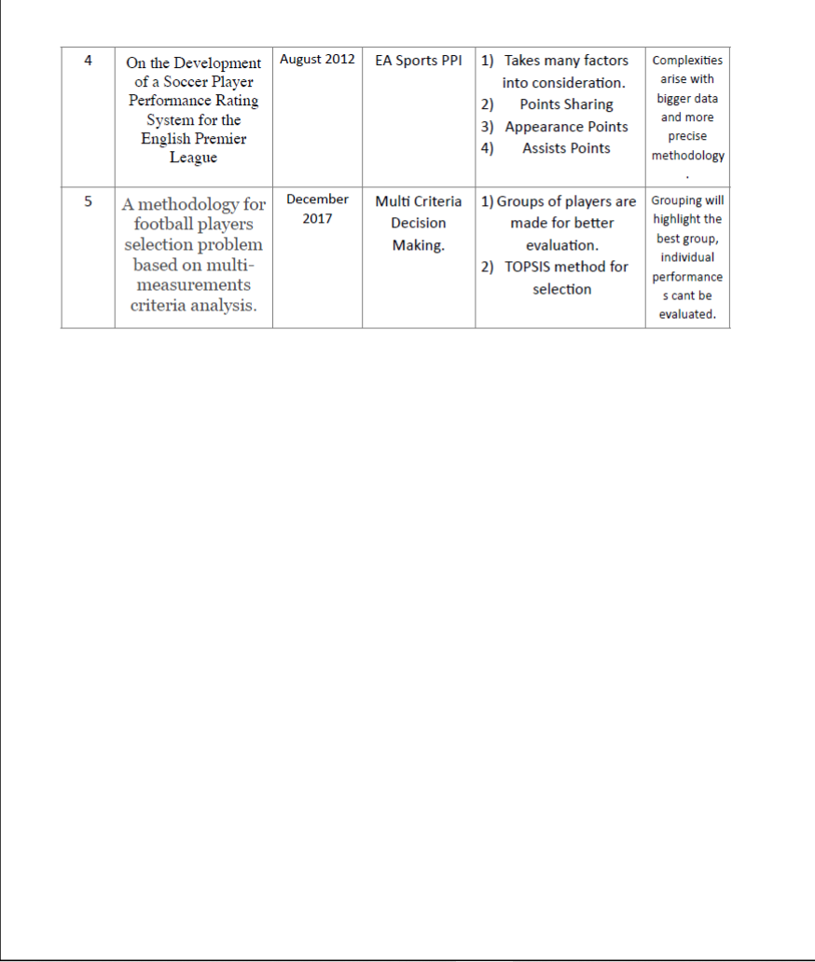

Slide 6
About Dataset
The datasets include player data after end of a season (in our case season 2019-2020) and is taken from Kaggle.
There are about 100+ attributes present in the dataset that includes almost all the details about all the football players active in that season.
Data like player position and also the role of player in the team plus player attributes with statistics as Attacking, Skills, Defense, Mentality, GK Skills, etc.
Also in addition player’s personal data like Nationality, Club, Date Of Birth, Wage, Salary, etc. has been provided along with the URL of the scraped player
Hence from this dataset we can train a model to not only predict player’s overall rating but also the potential that player carries.
With this dataset is being used to train the model, each member of our group has also decided to create a sample database consisting of players that are yet to be professional, so that we can predict how much potential such players carry in order to be a transfer target for the scouts.

Slide 7
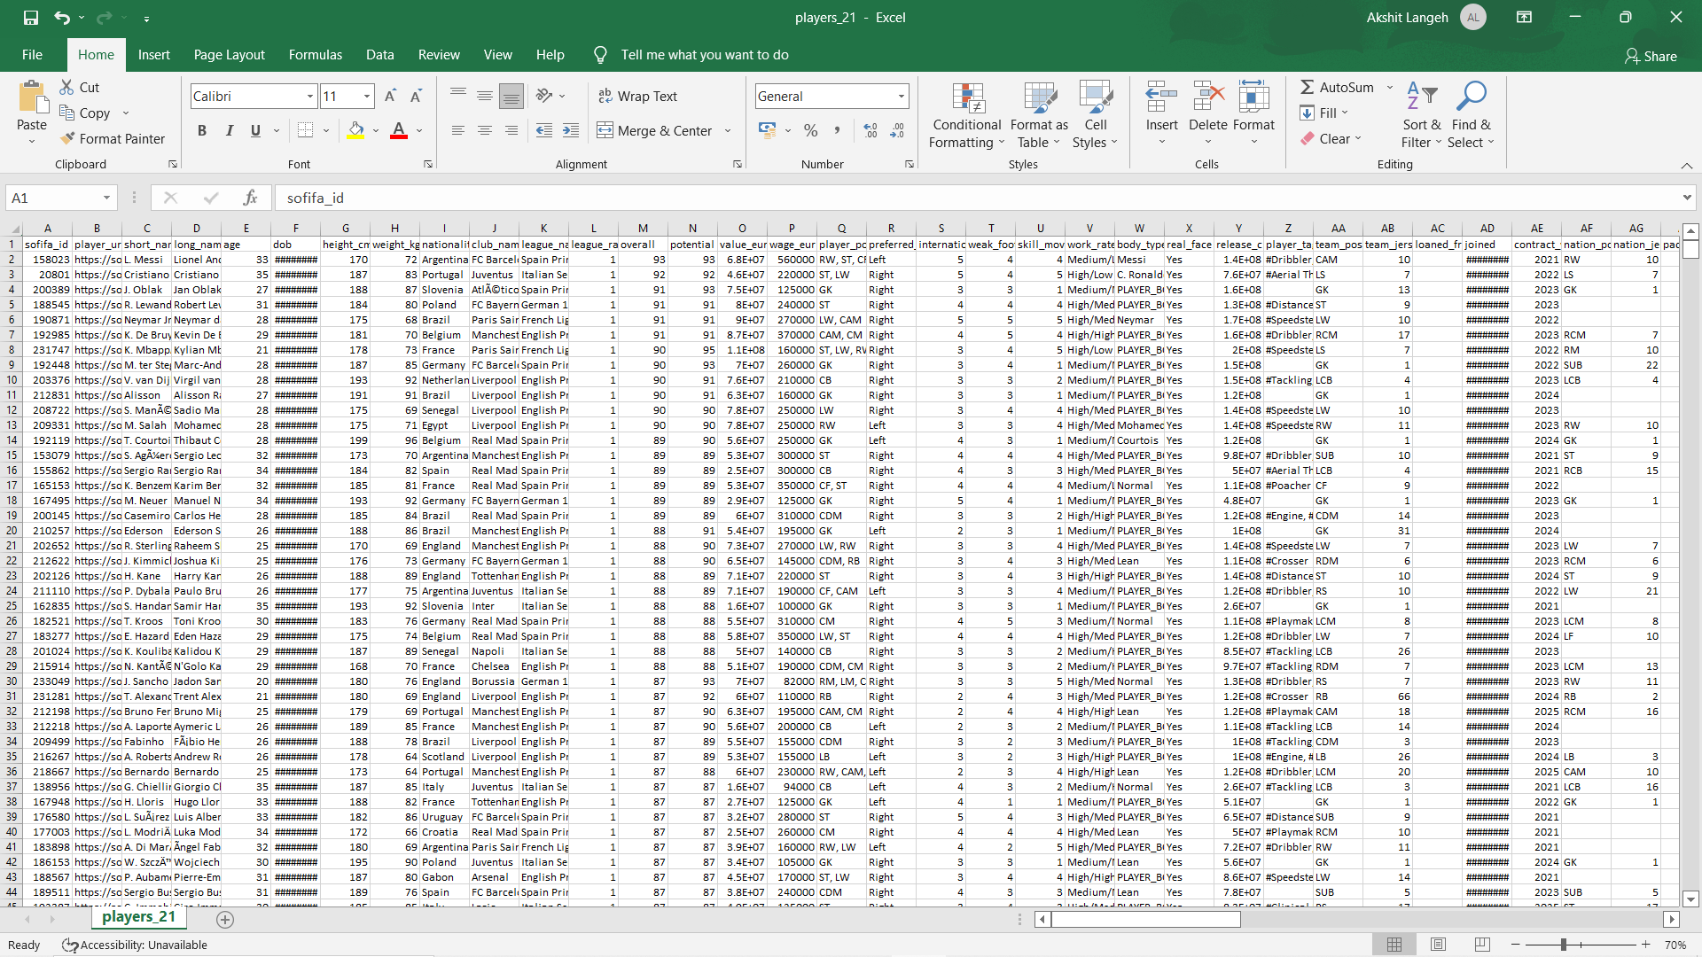

Slide 8
Abstract
Player rating prediction system is completely a data-driven model. To train the model we are using dataset from Kaggle which consist of about 106 columns and is obtained from EA sports player ratings. When trained, the model will be applied to another dataset which contains players that are yet to play at professional level thus providing us with their overall rating, their potential and also the position they will play in.
Firstly various data pre-processing techniques will be used to make data fit for the regression and classification algorithms. Data Reduction techniques need to be used to select a subset of attributes from the total attribute while data cleaning techniques to fill up the missing values and data transformation techniques to normalize and encode the data values.
After the data is processed then the features that are suitable for overall rating, potential rating and position prediction will be selected. The data so obtained will be trained using algorithms such as multiple linear regression, polynomial linear regression, random forest etc. and for position we need to use classification algorithms like KNN, decision tree, naïve bayes etc.
To calculate the accuracies of the various algorithms being used we will make use of R-square (regression) and confusion matrix (classification) such that appropriate model can be selected.
Data visualisation of the above dataset to provide insights and thus helping in analysis of player.

Slide 9
Implementation
Preprocessing and Testing - https://colab.research.google.com/drive/1zMwHRC_W7RkGD5PGcr46IaG8N0_uSQlZ
Test Case -
https://colab.research.google.com/drive/1TiTJBfSlQ0xHHvokjGCrHUc_BO2adW2Z

Slide 10
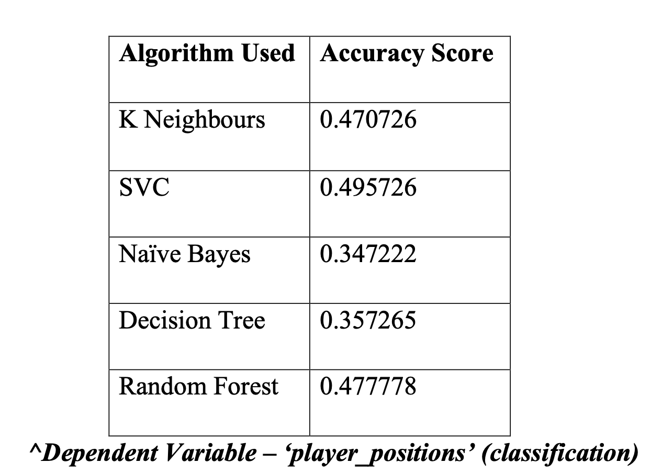
Observations

Slide 11
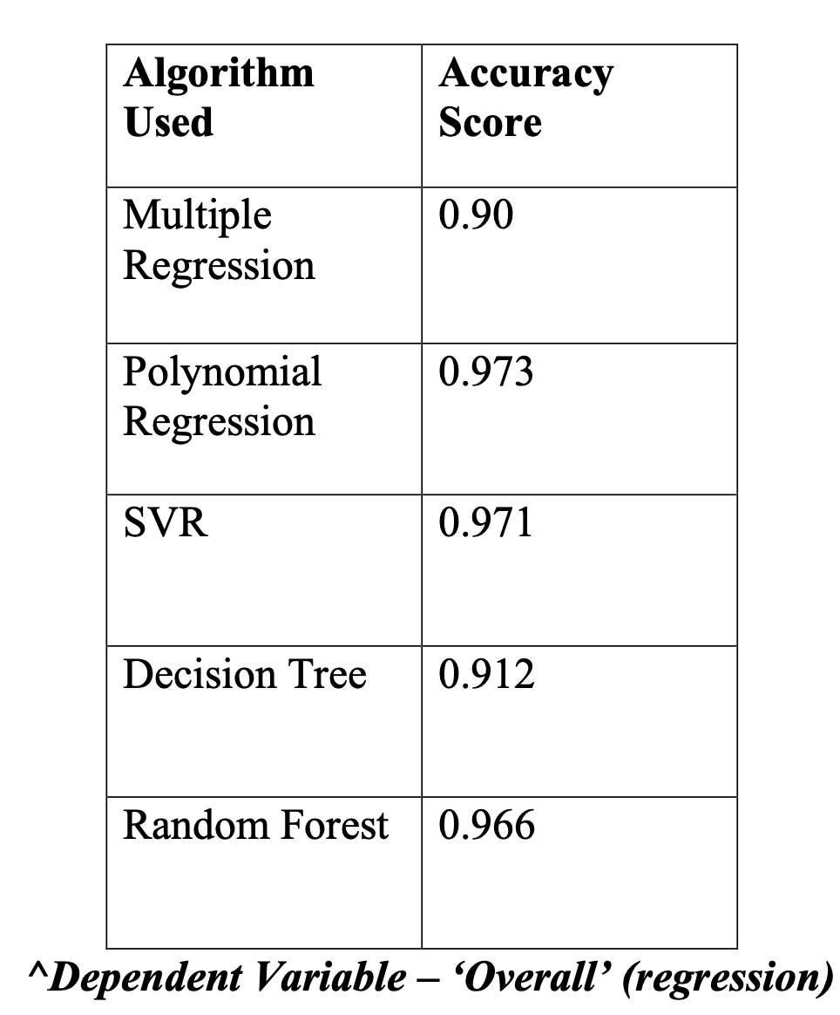
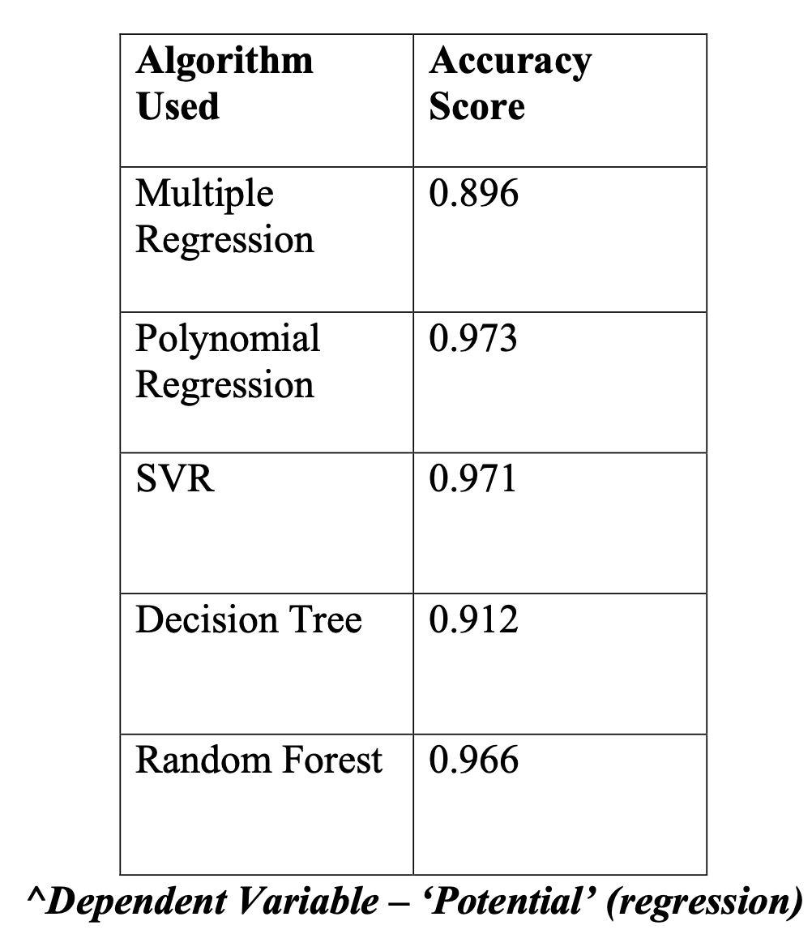

Slide 12
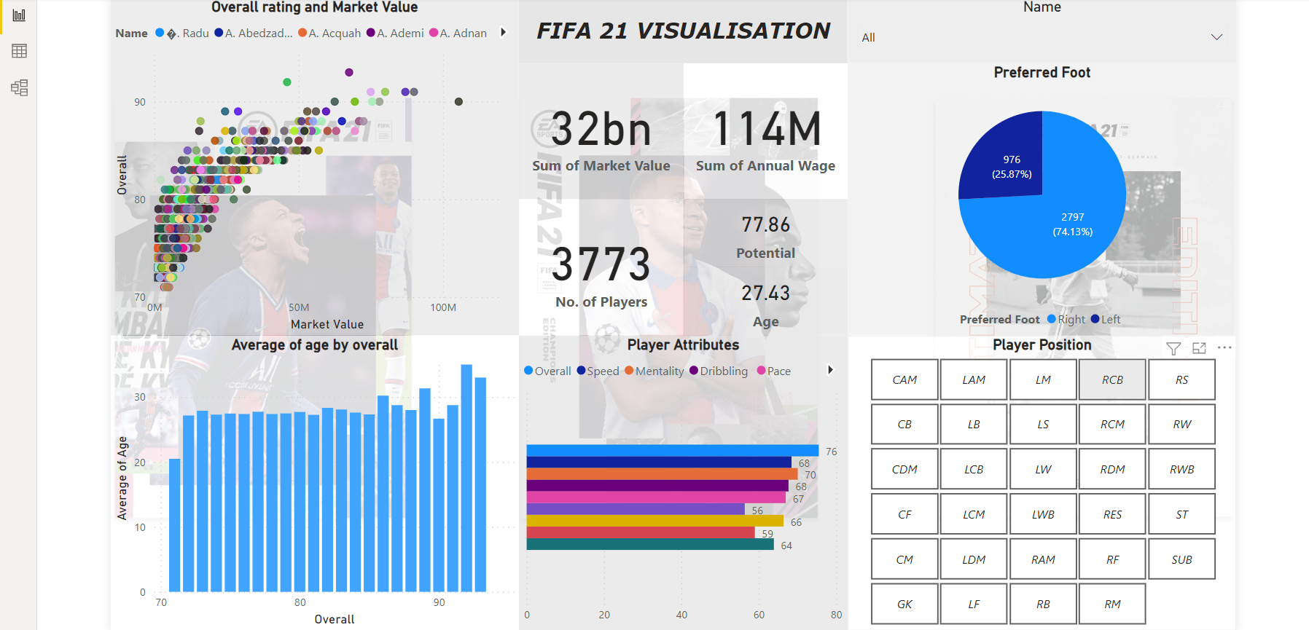
Visualization Dashboard

Slide 13
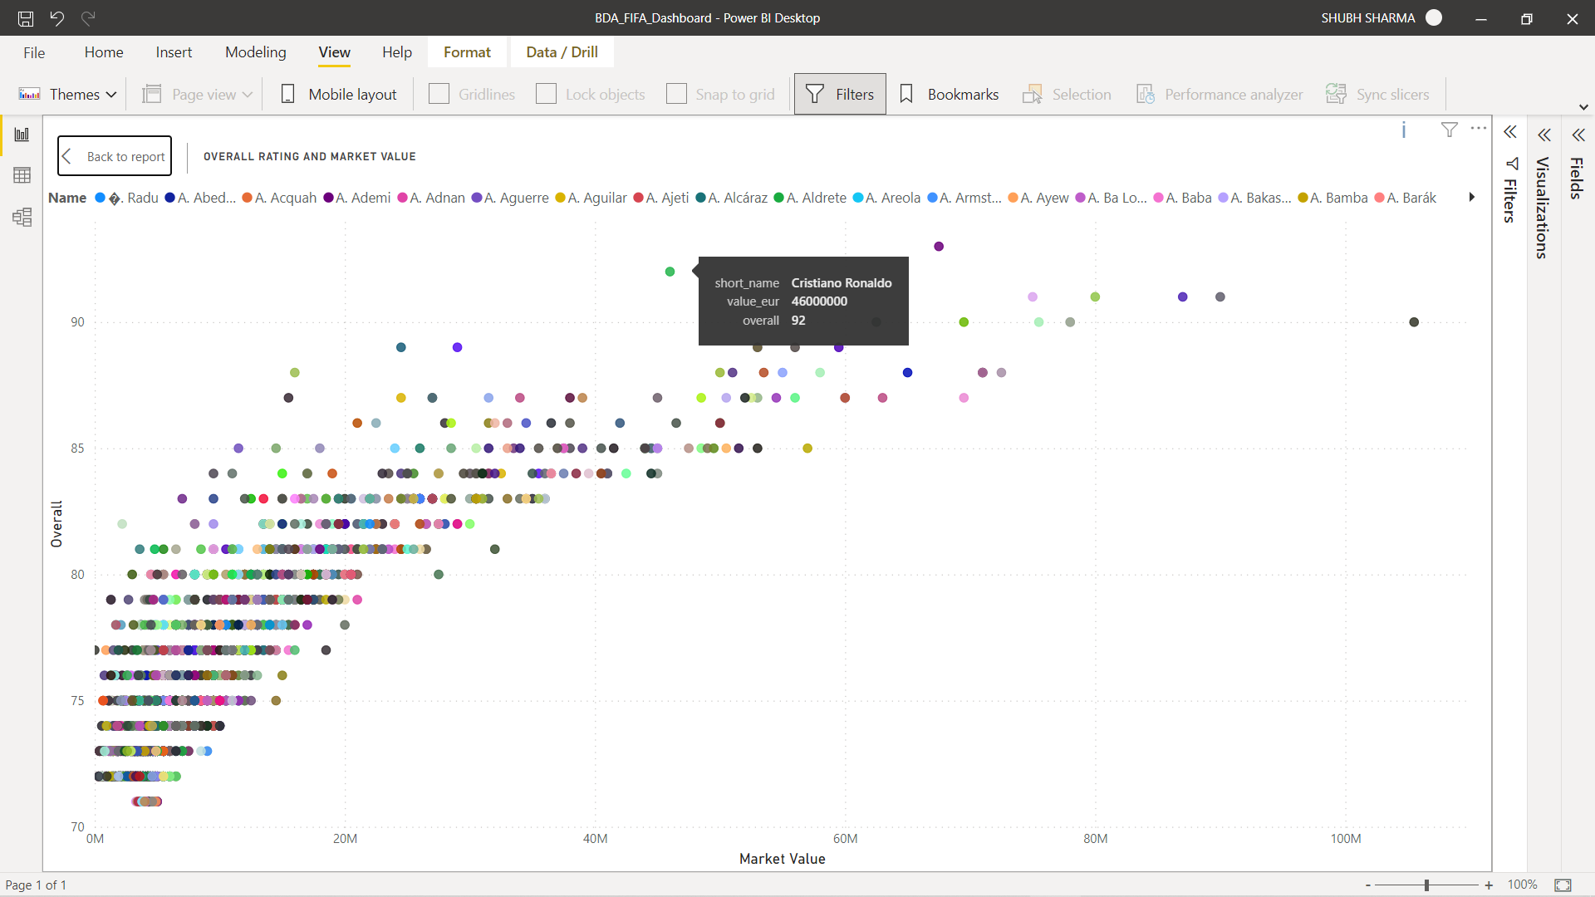
Player Overall rating vs Market Value

Slide 14
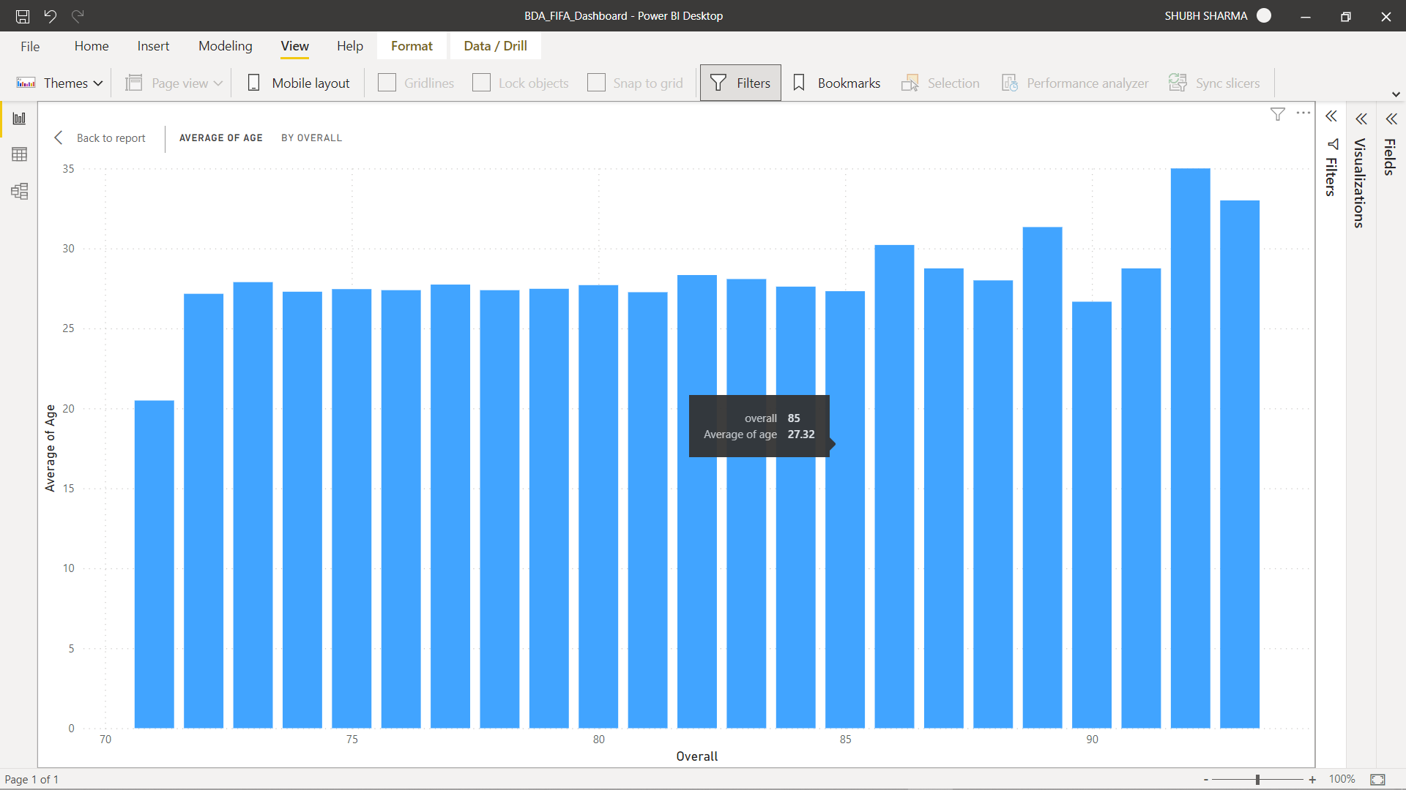
Average Age vs Overall Rating

Slide 15
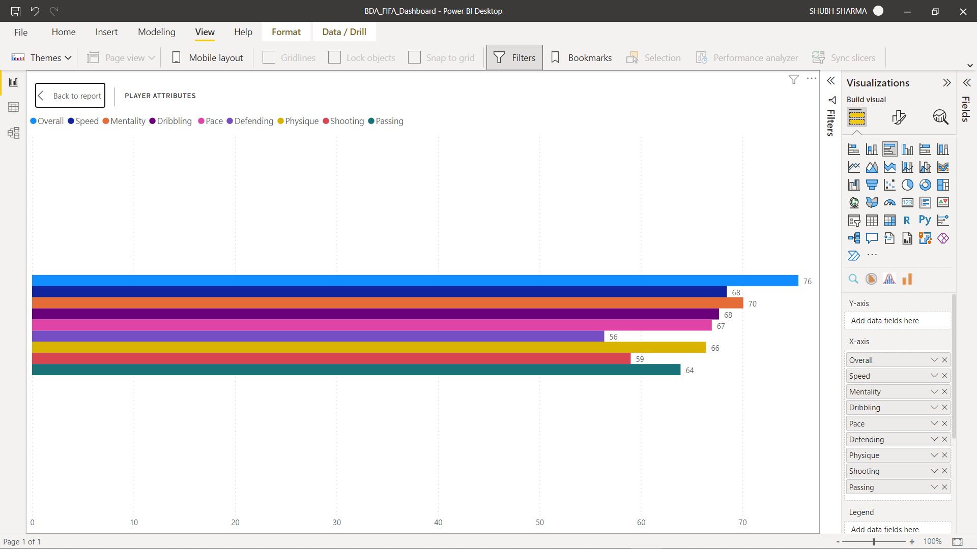
Players Attributes

Slide 16
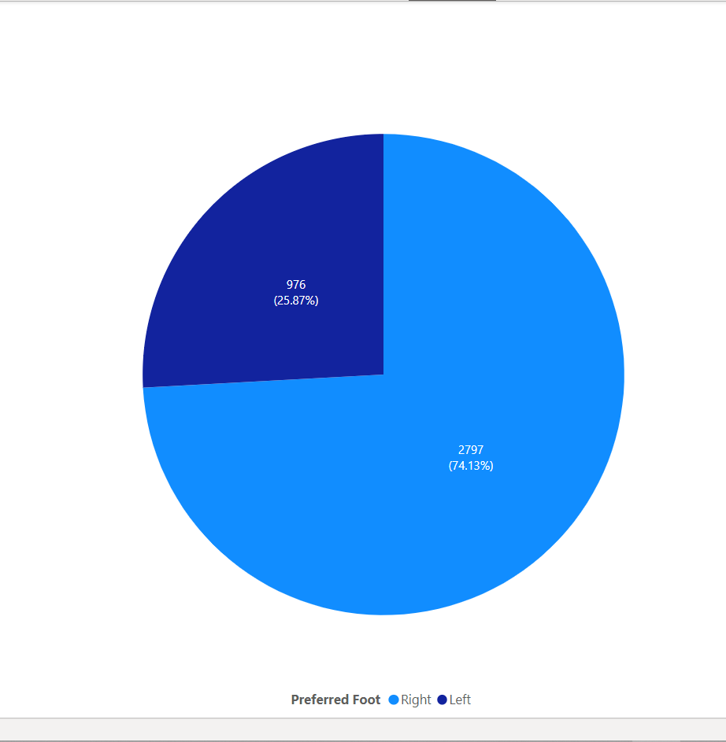
Pie chart visualization of distribution of preferred foot among Football Players

Slide 17
Novelty
The researches that uses the EA rating dataset is mostly used in video game engine but with our model the same can be applied to real world challenges by giving various scouts and sport related communities an opportunity to choose wisely among a huge array of non professional players available.
This model can be used to find how much potential does a young player carries and which roles in a team he can fulfil. The model once trained will be applied to the dataset consisting of non professional players and by virtue of which various features of the player can be calculated like the position or role of the player in a real or a fantasy team.
Another feature of the model is its flexibility as instead of football we can train it on other dataset that belong to other sport.

Slide 18
References
https://arxiv.org/pdf/1802.04987.pdf
https://rstudio-pubs-static.s3.amazonaws.com/524786_4d3da4afc6bd406c8f720572b460cc3e.html
https://towardsdatascience.com/predicting-premier-league-odds-from-ea-player-bfdb52597392
https://www.kaggle.com/
https://medium.com/analytics-vidhya/are-footballers-playing-in-their-best-positons-using-football-manager-dataset-a5346605541

